Slide 1
Do Incentives Work? Assessing the Impact of Economic Incentives on Industry Growth
Christian Conroy
PPOL 528-11
2018

Slide 2
Outline
Motivation
Question
Background & Literature Review
Conceptual Framework
Empirical Framework
Data
Description
Sample: selection criteria, size
Summary Stats
Preliminary Results

Slide 3
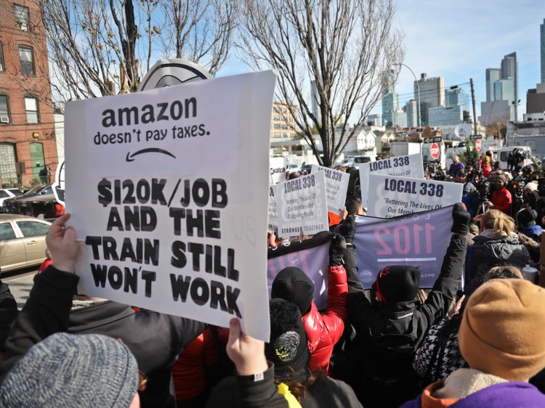

Motivation
State and local governments use incentives to attract and retain businesses
Many factors influence company’s decision to locate
Do incentives programs net out positively in the long run or do they give away the farm?
Politicians may only offer economic incentives to enhance reelection
Notes:
- Economic incentives include (at least in the case of my paper): Investment tax credits (ITC), Job Creation Tax Credit (JCTC), Research and Development tax credits (RDC), property tax abatement (PTA), and Custom Job Training Subsidies (CJTS)
If the incentive is not affecting the decision of the company, then instead it is just transferring wealth from taxpayers to high-income owners of large businesses
Scott Walker is the refutation of the electoral prospects thesis

Slide 4
Question
Do incentives offered by state and local governments to attract businesses actually result in increased business activity and positive GDP growth?

Slide 5
Background & Literature Review
They Work
They Sometimes Work
They Never Work
Companies do locate because of incentives
Benefits in jobs, wages, and economic growth more than offset short-term loss in tax revenue
Bureaucrats can be dumb
Mismatch between state and city goals
Front-loading tax breaks is more effective
Clawbacks and performance requirements
Incentives are not a factor in location decisions
Economic benefits do not outweigh upfront costs
Incentives crowd out investment and create bad capital allocation
Notes:
They Work
Do affect location decisions: (Bartik 2005, Rubin 1991, Chapman and Walker 1990, Walker and Greeenstreet 1989, Schmenner 1982)
Peters and Fisher (2004) find that offering a job creation tax credit equal to $2,800 per job for a branch plant would result in an increase of 30% in the probability of a firm choosing the offering location over a similar location not offering the incentive
More than offset revenue loss (Arguments): (Peters and Fisher 2004, Bartik 2003, Bartik 1991).
More than offset revenue loss (Empirical): (O’Connor 2011, Busso and Kline 2008, Bartik 2005, Wu 2005, Peters and Fisher 2004, Wasylenko and McGuire 1985, Newman 1983)
They Sometimes Work
Bureaucrats can be dumb: Some have pointed to human capital flaws in local economic development authorities that doom complex incentives structures from the start (Dewar 1998).
Mismatch of goals: Others sympathize with heads of economic development authorities as they are bound by the often competing incentives of higher-level government authorities with electoral interests
Frontloading: Bartik (2017) argues that shorter-term incentives that front-load tax breaks and subsidies have a higher likelihood of influencing relocation decisions and affecting long-term economic development prospects due to the way corporate accounting processes function
They Never Work
Not a factor in decisions: More survey based methodology - factors related to ease of living, human capital support, or corporate strategy matter more (Peters and Fisher 2004, Weber 2000, Rondinelli and Burpitt 2000, O’Mara 1999, Lynch 1995)
Economic incentives do not outweigh upfront costs (Argument): (Blomström 2002, Rodríguez‐Pose and Arbix 2001).
Do not outweigh costs (empirical): (De Blasio, Fantino, and Pellegrini 2014, Peters 2002, Rodriguez-Pose and Arbiz 2001, Boarnet and Bogart 1996, Schweke, Rist, and Dabson 1994, Carlton 1983)
Crowd out: While they do increase R&D spending within the state in the short-term, they also draw it away from other localities in the long-term, resulting in no net gain overall (Wilson 2009) (Wilson 2009, Gorin 2008, Peters and Fisher 2004, Fisher and Peters 1997)
Methodology Problems
Survey methodology
Case studies
Mismatch of unit analysis – Impact of city incentives on state gdp growth
No control group and just looked over time
Too short of a timeline of analysis

Slide 6
Conceptual Framework
Large company with jobs and economic growth prospects relocating
Investment Tax Credit (ITC)
Job Creation Tax Credit (JCTC)
Research and Development Tax Credit (RDC)
Property Tax Abatement (PTA)
Custom Job Training Subsidy (CJTS)
Nudge a Company to Choose the Location
Increased Jobs, Tax Revenue, and Wage Increases
Better public services and amenities

Slide 7
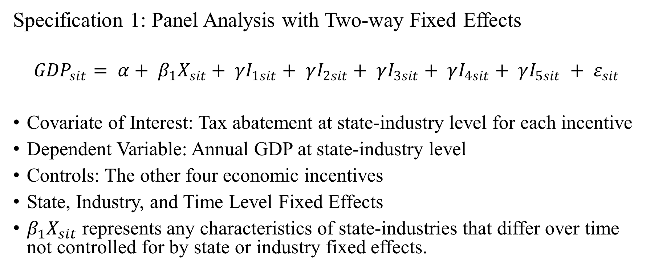
Empirical Framework
Specification 1: Panel Analysis with Two-way Fixed Effects
$${GDP}_{sit}= α+ β_{1}X_{sit}+ γI_{1sit}+ γI_{2sit}+ γI_{3sit}+ γI_{4sit}+ γI_{5sit} + ε_{sit}$$
Covariate of Interest: Tax abatement at state-industry level for each incentive
Dependent Variable: Annual GDP at state-industry level
Controls: The other four economic incentives
State, Industry, and Time Level Fixed Effects
$β_{1}X_{sit}$ represents any characteristics of state-industries that differ over time not controlled for by state or industry fixed effects.
Notes:
First, state-industry-level fixed effects will be included to capture differences across combinations of the 33 states and 45 industries included in the sample. Second, year-level fixed effects will be included to account for potential shocks in a given year (the years covering the financial crisis are included in the dataset, for example).
Demographics change over time differently for states, so this would be something to control for in the observed, and same for the visaversa with time

Slide 8
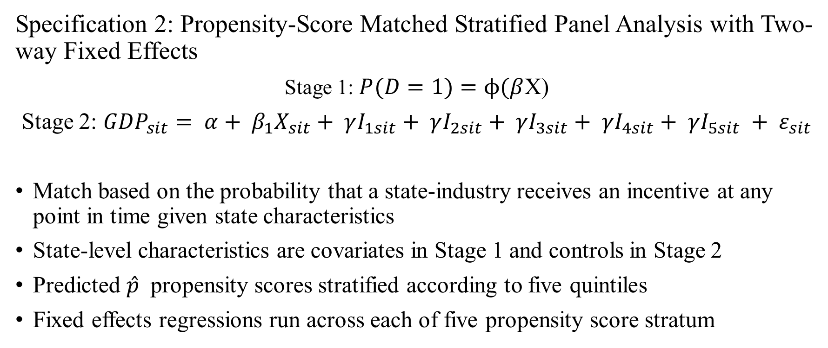
Empirical Framework
Specification 2: Propensity-Score Matched Stratified Panel Analysis with Two-way Fixed Effects
Stage 1: $P(D=1)=ϕ(β$X)
Stage 2: ${GDP}_{sit}= α+ β_{1}X_{sit}+ γI_{1sit}+ γI_{2sit}+ γI_{3sit}+ γI_{4sit}+ γI_{5sit} + ε_{sit}$
Match based on the probability that a state-industry receives an incentive at any point in time given state characteristics
State-level characteristics are covariates in Stage 1 and controls in Stage 2
Predicted $\hat{p}$ propensity scores stratified according to five quintiles
Fixed effects regressions run across each of five propensity score stratum
Notes:
The above is also down for the index of economic incentives

Slide 9
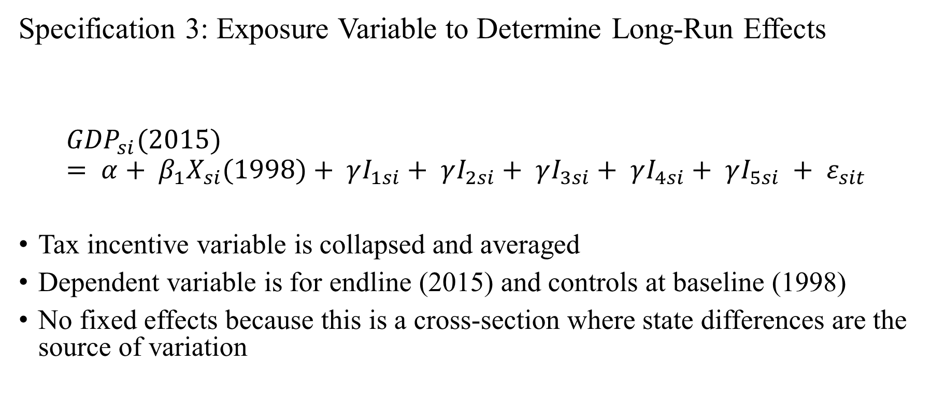
Empirical Framework
Specification 3: Exposure Variable to Determine Long-Run Effects
$${GDP}_{si}(2015)= α+ β_{1}X_{si}(1998)+ γI_{1si}+ γI_{2si}+ γI_{3si}+ γI_{4si}+ γI_{5si} + ε_{sit}$$
Tax incentive variable is collapsed and averaged
Dependent variable is for endline (2015) and controls at baseline (1998)
No fixed effects because this is a cross-section where state differences are the source of variation
Notes:
The above is also done for the index of incentives
Collapse process: Multiply each incentive tax abatement by the dummy of whether the industry had it that year, add together, and divide by t (Add up the tax abatements and divide by t
In any case, it is a cross-section regression using GDP in 2015; you can't include state dummies here because it's the only source of identifying variation you have.

Slide 10

Data
W.E. Upjohn Institute for Employment Research Panel Database on Incentives and Taxes
45 industries in 47 cities in 33 states collected from 1990 to 2015
Dataset is not a repository of actual incentives but is a “tax and incentive simulation”
Notes:
33 states compose 92 percent of US GDP and the 45 industries compose 91 percent of US labor compensation
like that maintained by Incentives Monitor
Instead, the database is derived from carrying out a “tax and incentive simulation” whereby a business in some industry i creates a new branch facility to be set up in city c in state s that will start operation in year t
Overall, what amounts to 65 percent of total state and local business taxes is covered in the dataset, with that number being higher for industries that are not subject to taxes left out of the database such as public utility taxes and insurance premium taxes
C2ER: Council for Community and Economic Research (C2ER)
The “output, value-added, real and personal property, labor, and purchases of intermediate inputs” the branch facility would bring comes from a constructed balance sheet derived from BEA Industry accounts data, IRS data on Statistics and Income, and National Science Foundation data on R&D spending

Slide 11
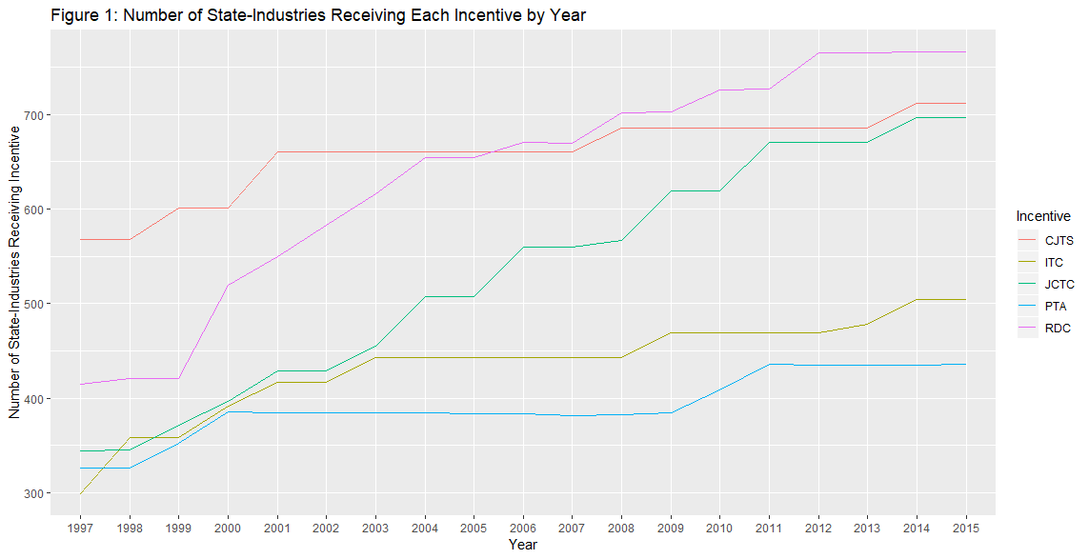
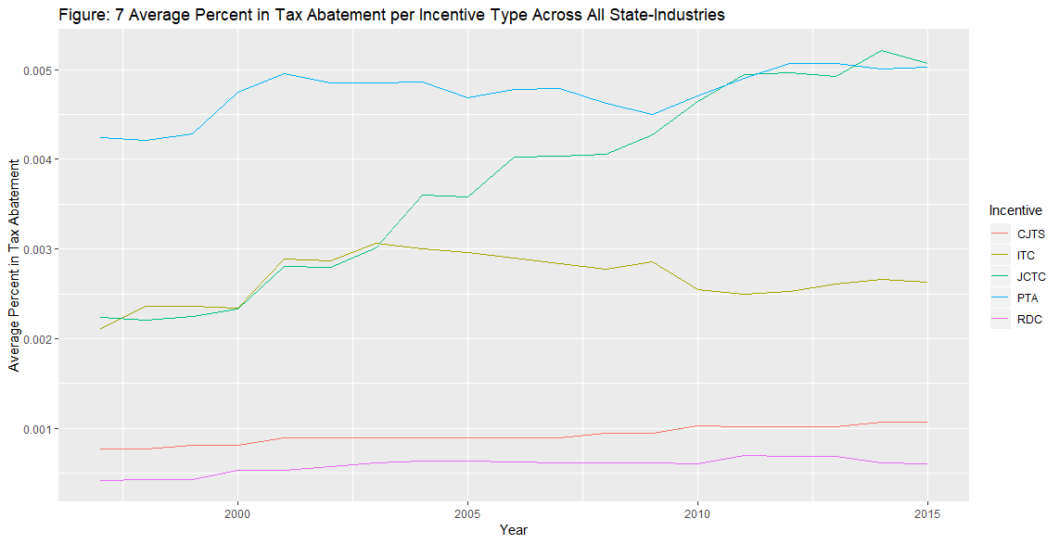
Data
Information in incentives rates come primarily from:
C2ER
Good Jobs First
Local laws and policies
Websites of city and state EDAs
Information on state and local taxes comes from:
Lincoln Institute of Land Policy
Minnesota Center for Fiscal Excellence
Gross tax receipts from Commerce Clearing House State Tax Guides
Notes:
C2ER: Council for Community and Economic Research (C2ER)
The “output, value-added, real and personal property, labor, and purchases of intermediate inputs” the branch facility would bring comes from a constructed balance sheet derived from BEA Industry accounts data, IRS data on Statistics and Income, and National Science Foundation data on R&D spending
Property tax abatements tend to be utilized the least, which makes sense given that property taxes often serve as the primary source of revenue generation for municipalities across the country.

Slide 12
Data - Update
Panel Database is merged with state-industry GDP data and state economic profiles from BEA, and state government spending data from the U.S. Census
1990-1996 data dropped due to SIC to NAICS code switch in 1997
1997 data dropped due to limitations on GDP data from BEA
DC dropped in state government spending data
Final dataset contains 19,568 observations.
Notes:
The GDP data collected by BEA is comprised of three components: labor income (wages, salaries, and other benefits), business taxes (excise, sales, property, and other business expense taxes), and capital income (income earned by individual or business and deprivation)
Each data point is collected through a rigorous methodology that includes estimation using BEA’s state personal income (SPI)and industry accounts, business payment and financial data from the Census Bureau, and value-added data from the Department of Agriculture.
While tools to crosswalk SIC and NAICS codes do exist, it is impossible to match the definitions without over or under counting the GDP levels of specific industry groupings and BEA even cautions scholars against trying to append the datasets together to develop a consistent timeline for 1963 to 2016
We run for both with DC though

Slide 13
Empirical Results

Slide 14
State-Industry GDP Dependent Variable
Full Sample: No Government Financing Variables Included

Slide 15
 | (1) | (2) | (3) | (4) | (5) | (6) | (7) | (8) | (9) | (10) | (11)
VARIABLES | Base Model - Index | Base Model - Each Incentive | FE - Index | FE - Each Incentive | PSM-Backed FE - Index - Strata 1 | PSM-Backed FE - Index - Strata 2 | PSM-Backed FE - Index - Strata 3 | PSM-Backed FE - Index – Strata 4 | PSM-Backed FE - Index – Strata 5 | Exposure Model - Index | Exposure Model - Each Incentive
jctc |  | -20,604 |  | -91,586**
 |  | (13,382) |  | (36,901)
itc |  | -45,777*** |  | -91,886
 |  | (12,211) |  | (150,527)
rdc |  | 428,268*** |  | 426,663**
 |  | (61,531) |  | (197,557)
pta |  | 103,740*** |  | 120,004**
 |  | (6,952) |  | (45,513)
cjts |  | -59,505** |  | -5,096
 |  | (24,573) |  | (217,261)
matchindex | 3.311e+06*** |  | 3.451e+06*** |  | 1.412e+06** | 2.268e+06*** | 3.390e+06*** | 3.994e+06*** | 5.839e+06***
 | (147,944) |  | (816,610) |  | (536,477) | (513,387) | (675,767) | (781,129) | (1.540e+06)
avgindex |  |  |  |  |  |  |  |  |  | 4.845e+06***
 |  |  |  |  |  |  |  |  |  | (1.337e+06)
avgjctc |  |  |  |  |  |  |  |  |  |  | -122,823**
 |  |  |  |  |  |  |  |  |  |  | (50,618)
avgitc |  |  |  |  |  |  |  |  |  |  | -102,599
 |  |  |  |  |  |  |  |  |  |  | (137,121)
avgrdc |  |  |  |  |  |  |  |  |  |  | 770,467*
 |  |  |  |  |  |  |  |  |  |  | (378,553)
avgpta |  |  |  |  |  |  |  |  |  |  | 171,006**
 |  |  |  |  |  |  |  |  |  |  | (68,994)
avgcjts |  |  |  |  |  |  |  |  |  |  | -42,671
 |  |  |  |  |  |  |  |  |  |  | (214,259)
Observations | 19,568 | 19,568 | 19,568 | 19,568 | 3,927 | 3,927 | 3,894 | 3,927 | 3,893 | 1,087 | 1,087
R-squared | 0.486 | 0.381 | 0.326 | 0.185 | 0.305 | 0.366 | 0.410 | 0.365 | 0.389 | 0.496 | 0.397
Notes:
Smallest SEs on exposure model, but still big
Index: Positive statistical significance in all three models (But large Ses)
JCTC: Negative Statistical Significance in Models 1 and 3
ITC: Negative but not statistically significant in Models 1 and 3
RDC: Positive and SS in 1 and 3
PTA: Positive statistical significance in 1 and 3
CJTS:Negative but not stat sig in both

Slide 16
State GDP Dependent Variable
Full Sample: No Government Financing Variables Included

Slide 17
 | (1) | (2) | (3) | (4) | (5) | (6) | (7) | (8) | (9) | (10) | (11)
VARIABLES | Base Model - Index | Base Model - Each Incentive | FE - Index | FE - Each Incentive | PSM-Backed FE - Index - Strata 1 | PSM-Backed FE - Index - Strata 2 | PSM-Backed FE - Index - Strata 3 | PSM-Backed FE - Index - Strata 4 | PSM-Backed FE - Index - Strata 5 | Exposure Model - Index | Exposure Model - Each Incentive
jctc |  | 1.859e+06*** |  | 520,490
 |  | (79,433) |  | (401,609)
itc |  | -31,173 |  | -175,081
 |  | (78,891) |  | (171,684)
rdc |  | 111,805 |  | 175,760
 |  | (235,111) |  | (163,266)
pta |  | 772,391*** |  | -118,224
 |  | (39,952) |  | (121,314)
cjts |  | -2.676e+06*** |  | -303,462
 |  | (153,032) |  | (329,651)
matchindex | 2.797e+06*** |  | 347,787* |  | 57,293 | 48,681 | 169,365* | 160,717* | 618.3
 | (355,567) |  | (201,694) |  | (43,511) | (29,793) | (88,515) | (89,429) | (143,413)
avgindex |  |  |  |  |  |  |  |  |  | -1.078e+06
 |  |  |  |  |  |  |  |  |  | (1.598e+06)
avgjctc |  |  |  |  |  |  |  |  |  |  | 771,800
 |  |  |  |  |  |  |  |  |  |  | (915,271)
avgitc |  |  |  |  |  |  |  |  |  |  | 478,821
 |  |  |  |  |  |  |  |  |  |  | (791,676)
avgrdc |  |  |  |  |  |  |  |  |  |  | 3.284e+06*
 |  |  |  |  |  |  |  |  |  |  | (1.661e+06)
avgpta |  |  |  |  |  |  |  |  |  |  | -1.065e+06
 |  |  |  |  |  |  |  |  |  |  | (692,216)
avgcjts |  |  |  |  |  |  |  |  |  |  | 683,723
 |  |  |  |  |  |  |  |  |  |  | (3.204e+06)
Observations | 19,568 | 19,568 | 19,568 | 19,568 | 3,927 | 3,927 | 3,894 | 3,927 | 3,893 | 1,087 | 1,087
R-squared | 0.984 | 0.985 | 0.956 | 0.957 | 0.987 | 0.992 | 0.992 | 0.995 | 0.990 | 0.993 | 0.994
Notes:
Nothing is really significant here, with the exception of a positive impact of rdc over time, which I guess makes sense.
\Matchindex is to some degree, but questionable given only S3 and S4 significant

Slide 18
Industry Value Added GDP Dependent Variable
Full Sample: No Government Financing Variables Included

Slide 19
 | (1) | (2) | (3) | (4) | (5) | (6) | (7) | (8) | (9) | (10) | (11)
VARIABLES | Base Model - Index | Base Model - Each Incentive | FE - Index | FE - Each Incentive | PSM-Backed FE - Index - Strata 1 | PSM-Backed FE - Index - Strata 2 | PSM-Backed FE - Index - Strata 3 | PSM-Backed FE - Index – Strata 4 | PSM-Backed FE - Index – Strata 5 | Exposure Model - Index | Exposure Model - Each Incentive
jctc |  | -2.821e+08* |  | -1.761e+09***
 |  | (1.565e+08) |  | (5.940e+08)
itc |  | -3.922e+08** |  | 4.774e+08
 |  | (1.787e+08) |  | (7.742e+08)
rdc |  | 4.025e+09*** |  | 6.122e+08
 |  | (4.984e+08) |  | (9.417e+08)
pta |  | 2.069e+09*** |  | 2.123e+09***
 |  | (1.412e+08) |  | (3.607e+08)
cjts |  | -3.180e+09*** |  | -1.480e+10***
 |  | (5.826e+08) |  | (2.728e+09)
matchindex | 3.197e+10*** |  | 3.198e+10*** |  | 3.044e+10*** | 4.166e+10*** | 3.463e+10*** | 3.060e+10*** | 2.641e+10***
 | (1.457e+09) |  | (4.290e+09) |  | (5.897e+09) | (5.861e+09) | (6.310e+09) | (6.271e+09) | (6.511e+09)
IncentivesTab |  |  |  |  | -1.355e+07 | -8.146e+06 | 2.897e+07 | 1.465e+07 | 9.018e+07**
 |  |  |  |  | (8.248e+06) | (1.568e+07) | (1.767e+07) | (1.765e+07) | (3.572e+07)
avgindex |  |  |  |  |  |  |  |  |  | 3.719e+10***
 |  |  |  |  |  |  |  |  |  | (4.329e+09)
avgjctc |  |  |  |  |  |  |  |  |  |  | -1.175e+09
 |  |  |  |  |  |  |  |  |  |  | (7.138e+08)
avgitc |  |  |  |  |  |  |  |  |  |  | -8.982e+08
 |  |  |  |  |  |  |  |  |  |  | (8.224e+08)
avgrdc |  |  |  |  |  |  |  |  |  |  | 5.126e+09***
 |  |  |  |  |  |  |  |  |  |  | (1.692e+09)
avgpta |  |  |  |  |  |  |  |  |  |  | 3.137e+09***
 |  |  |  |  |  |  |  |  |  |  | (5.378e+08)
avgcjts |  |  |  |  |  |  |  |  |  |  | -9.329e+09***
 |  |  |  |  |  |  |  |  |  |  | (2.666e+09)
Constant |  |  |  |  | 9.788e+08*** | 7.783e+08*** | 2.334e+08 | 8.330e+08*** | 4.367e+08*
 |  |  |  |  | (1.696e+08) | (1.467e+08) | (1.726e+08) | (2.428e+08) | (2.254e+08)
Observations | 19,568 | 19,568 | 19,568 | 19,568 | 3,927 | 3,927 | 3,894 | 3,927 | 3,893 | 1,087 | 1,087
R-squared | 0.458 | 0.435 | 0.495 | 0.480 | 0.513 | 0.519 | 0.497 | 0.503 | 0.501 | 0.479 | 0.459
Robust Standard Errors | YES | YES | YES | YES | YES | YES | YES | YES | YES | YES | YES
Long-Term Effects |  |  |  |  |  |  |  |  |  | YES | YES
Number of State_num_id |  |  | 33 | 33 | 21 | 28 | 28 | 26 | 20
State-Industry FE |  |  | YES | YES | YES | YES | YES | YES | YES
Year FE |  |  | YES | YES | YES | YES | YES | YES | YES
Notes:
Looks to be similar story as SI GDP
Though, JCTC loses statsig

Slide 20
State-Industry GDP Dependent Variable with Government Financing Controls
Reduced Sample: State financing variables knock out DC

Slide 21
 | (1) | (2) | (3) | (4) | (5) | (6) | (7) | (8) | (9) | (10) | (11)
VARIABLES | Base Model - Index | Base Model - Each Incentive | FE - Index | FE - Each Incentive | PSM-Backed FE - Index - Strata 1 | PSM-Backed FE - Index – Strata 2 | PSM-Backed FE - Index - Strata 3 | PSM-Backed FE - Index - Strata 4 | PSM-Backed FE - Index - Strata 5 | Exposure Model - Index | Exposure Model - Each Incentive
jctc |  | -42,093*** |  | -166,042***
 |  | (12,220) |  | (45,355)
itc |  | -64,456*** |  | -200,327
 |  | (12,751) |  | (158,046)
rdc |  | 440,375*** |  | -430,212**
 |  | (61,824) |  | (170,490)
pta |  | 101,738*** |  | 37,668
 |  | (7,641) |  | (48,860)
cjts |  | -36,037 |  | -265,176
 |  | (24,577) |  | (380,348)
matchindex | 3.356e+06*** |  | 3.493e+06*** |  | -236,704 | 1.538e+06** | 841,986* | 1.691e+06 | 3.561e+06
 | (150,318) |  | (831,137) |  | (673,026) | (634,923) | (476,884) | (1.361e+06) | (2.675e+06)
IncentivesTab |  |  |  |  | -198.8 | -1,250 | -2,468** | -1,199 | -1,798
 |  |  |  |  | (962.2) | (1,147) | (1,204) | (2,717) | (5,012)
avgindex |  |  |  |  |  |  |  |  |  | 4.932e+06***
 |  |  |  |  |  |  |  |  |  | (1.367e+06)
avgjctc |  |  |  |  |  |  |  |  |  |  | -125,157**
 |  |  |  |  |  |  |  |  |  |  | (50,606)
avgitc |  |  |  |  |  |  |  |  |  |  | -101,508
 |  |  |  |  |  |  |  |  |  |  | (142,935)
avgrdc |  |  |  |  |  |  |  |  |  |  | 789,377**
 |  |  |  |  |  |  |  |  |  |  | (379,449)
avgpta |  |  |  |  |  |  |  |  |  |  | 200,555**
 |  |  |  |  |  |  |  |  |  |  | (79,155)
avgcjts |  |  |  |  |  |  |  |  |  |  | -103,936
 |  |  |  |  |  |  |  |  |  |  | (252,250)
Observations | 19,008 | 19,008 | 19,008 | 19,008 | 807 | 806 | 807 | 806 | 806 | 1,056 | 1,056
R-squared | 0.489 | 0.383 | 0.331 | 0.345 | 0.351 | 0.476 | 0.389 | 0.387 | 0.429 | 0.498 | 0.398
Robust Standard Errors | YES | YES | YES | YES | YES | YES | YES | YES | YES | YES | YES
Long-Term Effects |  |  |  |  |  |  |  |  |  | YES | YES
Number of State_num_id |  |  | 32 | 32 | 29 | 31 | 32 | 28 | 20
State-Industry FE |  |  | YES | YES | YES | YES | YES | YES | YES
Year FE |  |  | YES | YES | YES | YES | YES | YES | YES
Notes:
Index: Positive statistical significance in 1 and 3, but only statsig in strats 2 and 3
JCTC: Negative Statistical Significance in Models 1 and 3 (Consistent)
ITC: Negative but not statistically significant in Models 1 and 3
RDC: Stat Sig in both, but negative in 1 and positive in 3 (Inconsistent)
PTA: Positive statistical significance in 3 but not in 1 (Inconsistent on stat sig)
CJTS:Negative but not stat sig in both

Slide 22
State GDP Dependent Variable with Government Financing Controls
Reduced Sample: State financing variables knock out DC

Slide 23
 | (1) | (2) | (3) | (4) | (5) | (6) | (7) | (8) | (9) | (10) | (11)
VARIABLES | Base Model - Index | Base Model - Each Incentive | FE - Index | FE - Each Incentive | PSM-Backed FE - Index - Strata 1 | PSM-Backed FE - Index – Strata 2 | PSM-Backed FE - Index - Strata 3 | PSM-Backed FE - Index – Strata 4 | PSM-Backed FE - Index - Strata 5 | Exposure Model - Index | Exposure Model - Each Incentive
jctc |  | 1.187e+06*** |  | 87,222
 |  | (49,367) |  | (158,741)
itc |  | -682,445*** |  | -133,289
 |  | (45,874) |  | (125,918)
rdc |  | 395,075** |  | 61,056
 |  | (177,519) |  | (133,100)
pta |  | 82,349*** |  | -133,551
 |  | (31,348) |  | (90,198)
cjts |  | -704,521*** |  | 276,289
 |  | (115,120) |  | (291,182)
matchindex | 636,021*** |  | 93,805 |  | -1.030e+06 | 390,944 | -125,854 | 501,491 | -1.955e+06*
 | (199,036) |  | (97,310) |  | (3.000e+06) | (575,260) | (323,114) | (517,050) | (969,515)
IncentivesTab |  |  |  |  | 4,371 | -4,023** | -3,111* | 3,356 | -2,013
 |  |  |  |  | (4,509) | (1,956) | (1,537) | (5,671) | (1,714)
avgindex |  |  |  |  |  |  |  |  |  | 174,515
 |  |  |  |  |  |  |  |  |  | (890,562)
avgjctc |  |  |  |  |  |  |  |  |  |  | 515,012
 |  |  |  |  |  |  |  |  |  |  | (572,474)
avgitc |  |  |  |  |  |  |  |  |  |  | 855,146
 |  |  |  |  |  |  |  |  |  |  | (522,191)
avgrdc |  |  |  |  |  |  |  |  |  |  | 1.321e+06
 |  |  |  |  |  |  |  |  |  |  | (1.006e+06)
avgpta |  |  |  |  |  |  |  |  |  |  | 135,745
 |  |  |  |  |  |  |  |  |  |  | (296,809)
avgcjts |  |  |  |  |  |  |  |  |  |  | -1.740e+06
 |  |  |  |  |  |  |  |  |  |  | (1.253e+06)
Observations | 19,008 | 19,008 | 19,008 | 19,008 | 807 | 806 | 807 | 806 | 806 | 1,056 | 1,056
R-squared | 0.991 | 0.991 | 0.972 | 0.972 | 0.986 | 0.973 | 0.992 | 0.989 | 0.992 | 0.998 | 0.998
Robust Standard Errors | YES | YES | YES | YES | YES | YES | YES | YES | YES | YES | YES
Long-Term Effects |  |  |  |  |  |  |  |  |  | YES | YES
Number of State_num_id |  |  | 32 | 32 | 29 | 31 | 32 | 28 | 20
State-Industry FE |  |  | YES | YES | YES | YES | YES | YES | YES
Year FE |  |  | YES | YES | YES | YES | YES | YES | YES

Slide 24
Industry Added Value Dependent Variable with Government Financing Controls
Reduced Sample: State financing variables knock out DC

Slide 25
 | (1) | (2) | (3) | (4) | (5) | (6) | (7) | (8) | (9) | (10) | (11)
VARIABLES | Base Model - Index | Base Model - Each Incentive | FE - Index | FE - Each Incentive | PSM-Backed FE - Index - Strata 1 | PSM-Backed FE - Index – Strata 2 | PSM-Backed FE - Index – Strata 3 | PSM-Backed FE - Index - Strata 4 | PSM-Backed FE - Index - Strata 5 | Exposure Model - Index | Exposure Model - Each Incentive
jctc |  | -2.104e+08 |  | -2.300e+09***
 |  | (1.657e+08) |  | (6.500e+08)
itc |  | -3.519e+08* |  | -6.529e+08
 |  | (1.874e+08) |  | (6.942e+08)
rdc |  | 4.226e+09*** |  | -7.535e+09***
 |  | (5.008e+08) |  | (1.739e+09)
pta |  | 2.157e+09*** |  | 1.465e+09***
 |  | (1.469e+08) |  | (4.458e+08)
cjts |  | -2.922e+09*** |  | -1.765e+10***
 |  | (5.973e+08) |  | (3.957e+09)
matchindex | 3.256e+10*** |  | 3.190e+10*** |  | -3.378e+10 | 5.600e+10*** | 6.766e+10*** | 1.012e+11** | 1.337e+11**
 | (1.491e+09) |  | (4.284e+09) |  | (3.127e+10) | (1.229e+10) | (2.188e+10) | (4.337e+10) | (4.933e+10)
IncentivesTab |  |  |  |  | -8.716e+07*** | -1.223e+08*** | -1.356e+08*** | -1.668e+08*** | -1.849e+08***
 |  |  |  |  | (2.459e+07) | (3.030e+07) | (4.655e+07) | (3.033e+07) | (4.072e+07)
avgindex |  |  |  |  |  |  |  |  |  | 3.739e+10***
 |  |  |  |  |  |  |  |  |  | (4.473e+09)
avgjctc |  |  |  |  |  |  |  |  |  |  | -1.196e+09
 |  |  |  |  |  |  |  |  |  |  | (7.245e+08)
avgitc |  |  |  |  |  |  |  |  |  |  | -1.013e+09
 |  |  |  |  |  |  |  |  |  |  | (8.417e+08)
avgrdc |  |  |  |  |  |  |  |  |  |  | 5.527e+09***
 |  |  |  |  |  |  |  |  |  |  | (1.826e+09)
avgpta |  |  |  |  |  |  |  |  |  |  | 3.402e+09***
 |  |  |  |  |  |  |  |  |  |  | (5.287e+08)
avgcjts |  |  |  |  |  |  |  |  |  |  | -9.577e+09***
 |  |  |  |  |  |  |  |  |  |  | (2.437e+09)
Observations | 19,008 | 19,008 | 19,008 | 19,008 | 807 | 806 | 807 | 806 | 806 | 1,056 | 1,056
R-squared | 0.460 | 0.436 | 0.496 | 0.513 | 0.650 | 0.658 | 0.622 | 0.658 | 0.705 | 0.482 | 0.461

Slide 26
Conclusions
Economic incentives in the aggregate appear to have a positive impact on the growth of a state-industry over time
The story is different for individual economic incentives
JCTC appear to produce a negative outcome
RDTC and PTA appear to produce positive outcomes
CJTS appears negative in terms of impact on industry added value
ITC inconclusive across the board
Findings on the impact of economic incentives on state-wide GDP growth are inconclusive
Government financing on amenities dilutes the effect of economic incentives in the aggregate
Notes:
ITC inconclusive across the board interesting due to OZs
State-industry GDP and industry added value largely tracked with the exception of CJTS
– the size and type of incentives can influence GDP growth but GDP growth can also affect the size and type of incentives
Too many ad hoc on deal by deal meaning that the modeling is not good enough
It is challenging, but ultimately might be easy to control for in regards to financial crisis
For example, with Amazon, we’re structuring all the performance requirements and such on a ten year timeline
Might be able to limit assessment timeline to before the incentives are dropped, but then we run into the how long does it take economic incentives issue

Slide 27
Considerations and Limitations
Considerations
Limitations
Two separate unit-level fixed effects (state and industry) or one (state-industry)
Triple Diff: Interacting fixed effects or controlling for observables
Removal of incentives in treatment groups
May be too many ad hoc parts of incentive programs
Financial crisis effect
How long does it take for economic incentives to make a difference?
Can’t get at “They Sometimes Work” outside of fixed effects
Notes:
– the size and type of incentives can influence GDP growth but GDP growth can also affect the size and type of incentives
Too many ad hoc on deal by deal meaning that the modeling is not good enough
It is challenging, but ultimately might be easy to control for in regards to financial crisis
For example, with Amazon, we’re structuring all the performance requirements and such on a ten year timeline
Might be able to limit assessment timeline to before the incentives are dropped, but then we run into the how long does it take economic incentives issue

